Slide 1
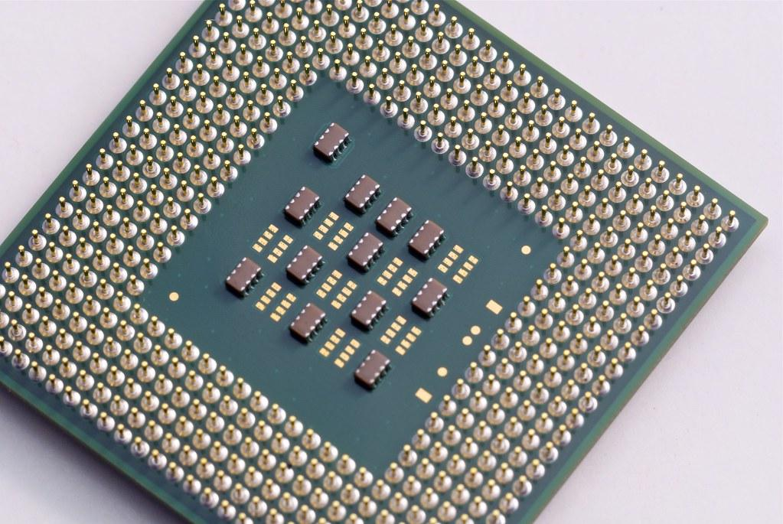
Building Thread-Safe Applications in Java
By: Anirudh Balasubramanian
Create multithreaded applications that take advantage of modern processing power

Slide 2
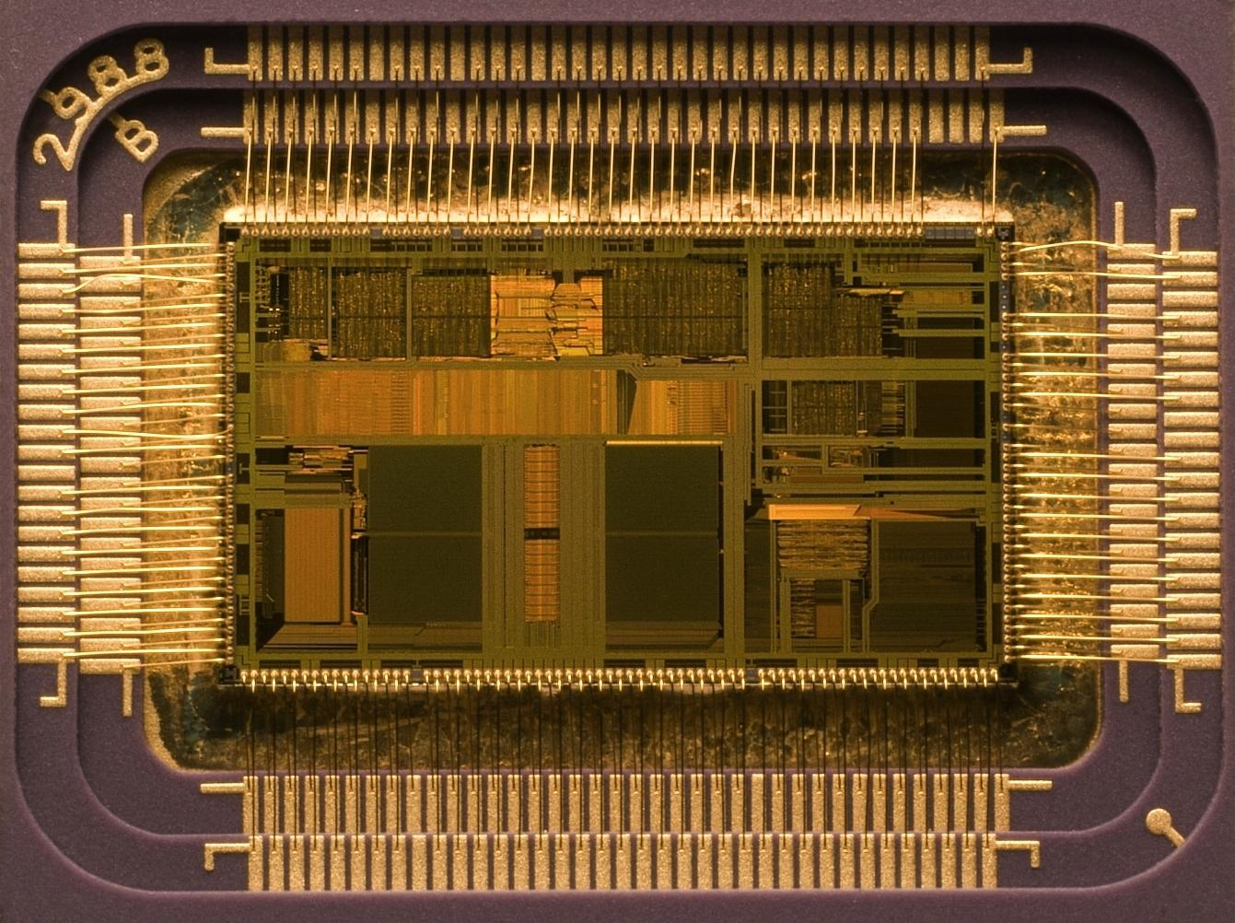
Introduction to Multithreading and Our Project

Slide 3
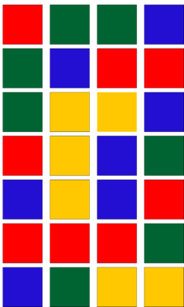
What are Threads and Why do we Care?
For any program you start on your computer, your operating system needs to allot it some system resources
These can be memory, disk space, CPU time, GPU time, VRAM, etc…
Each program is called a process, and each process has its own system resources
Generally process can’t share resources directly
Processes use messaging systems or the OS to communicate
Each process has one or more threads
By default, a Java program only has one thread
This is called the Main thread by convention
Inside of each thread is a series of instructions

Slide 4
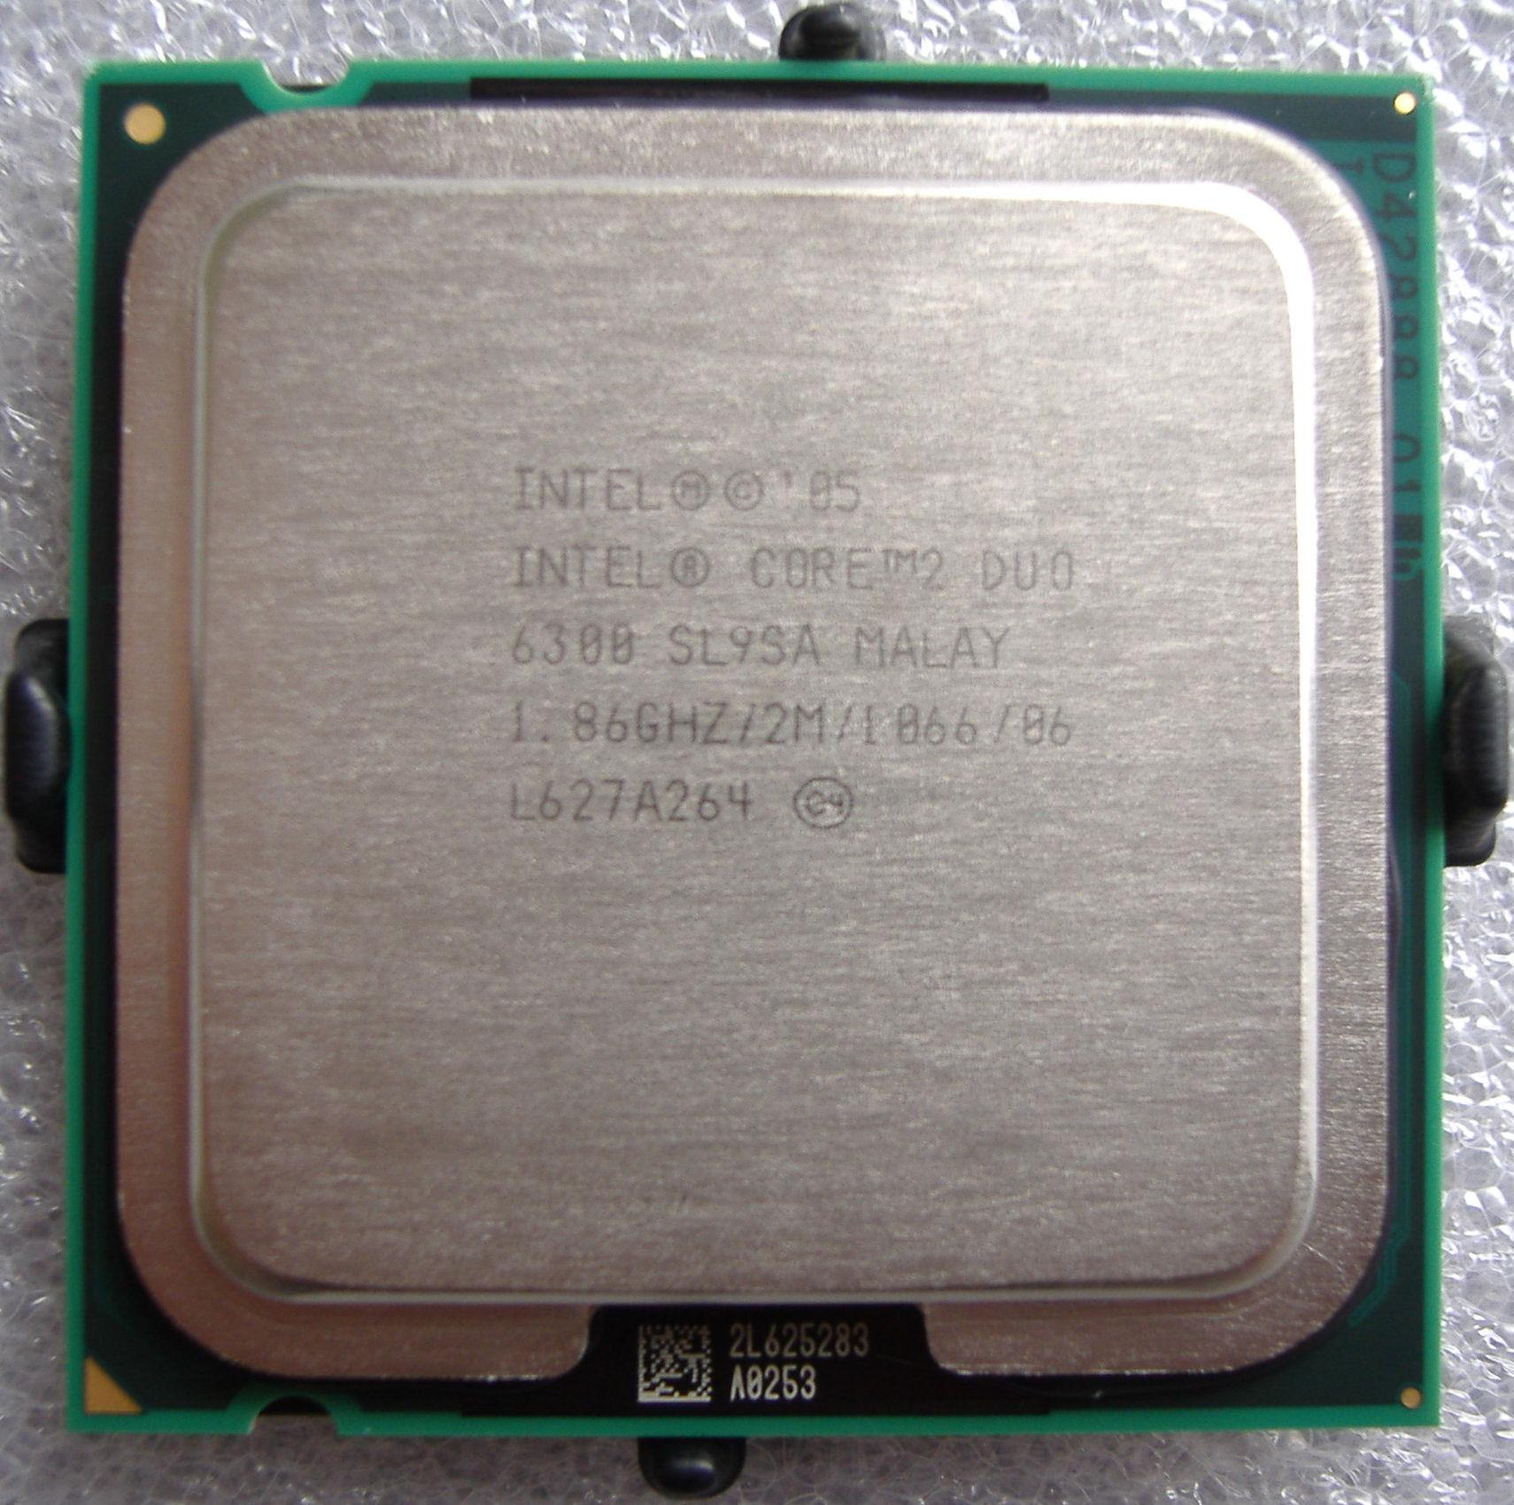
Multithreading and Modern Computing
In the old days, a CPU would only have one core
Thus, only one thread could be executed at a single time
Time-slicing is used to ensure that all the active threads get some CPU time
Modern computers can have multiple CPUs, multiple cores, or even hyperthreading
All of these tools allow us to run multiple threads at once in a computer
With well designed programs we can have multiple threads that efficiently use system resources and execute in parallel
The added complexity of multiple threads does require different design philosophies and techniques than single-thread programs
Parallel execution drives much of modern computing from Machine Learning, GUI interfaces, or just faster general computing

Slide 5
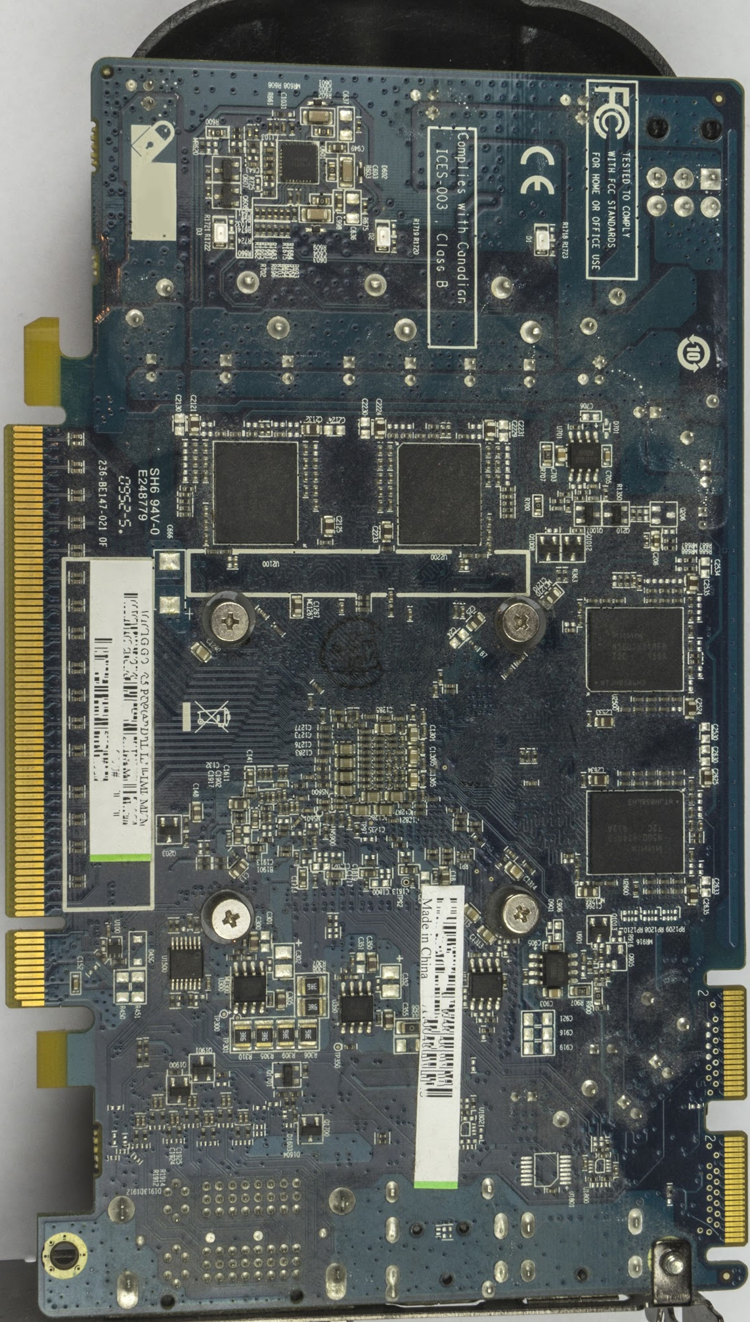
Multithreading in the Real World/Our Project
Even when you're coding, multiple threads are executing in the background to allow the GUI to update at the same time as your program and background processes
Video games depend on having many parallel tasks executing to ensure a user’s input can be processed at the same time as the game’s logic
Our program will be a thread-safe application that updates a user’s score from various threads simultaneously
We will see that thread-safe applications are harder to develop but can be orders of magnitude faster than single threaded programs

Slide 6

Our Project
We will learn how to make a threadsafe bank application that can be modified by multiple threads simultaneously
We will learn how to use multiple threads, and how to keep them all separated from each other
We will use Rhyme and Java to create our application
Your Rhyme VM should be pre-configured so you can get started once your desktop is connected

Slide 7


Introduction to Java Threads

Slide 8
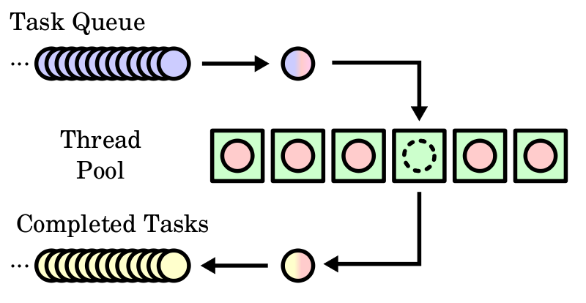
Introduction to Java Threads
Two main ways to create a Thread
Remember that by default we have the main thread executing our program
With Inheritance
Using inheritance, we can inherit the Thread class and then create instances of this class
Usually not used since Java doesn’t support multiple inheritance
With Interfaces
We can implement the Runnable interface which tells Java that this task can take a full thread
We have to make sure we keep track of when we use the class vs when we want to perform thread functions

Slide 9
Methods of the Thread Class
Constructors
Two constructors, default and one that creates a thread for a given Runnable object
Static Methods
Sleep
Sets thread to sleep for a given number of milliseconds
Can throw an InterruptedException which is checked
Most cases, we will put it inside of a try catch block
Exception only happens if a thread is interrupted, but this is extremely unlikely in modern code
Yield
Stops a thread temporarily and allows other threads system time

Slide 10
Methods of the Thread Class Cont.
Instance Methods
Start
Tells JVM to call the given instance’s run method
isAlive
Returns true if thread is currently running
setPriority
Sets priority of thread
Priorities range from 1-10 (10 is the max priority)
Constants such as Thread.MIN_PRIORITY are often used
Join
Waits for this thread to finish
Interrupt
Stops the thread by interrupting it

Slide 11

Thread Pools in Java

Slide 12
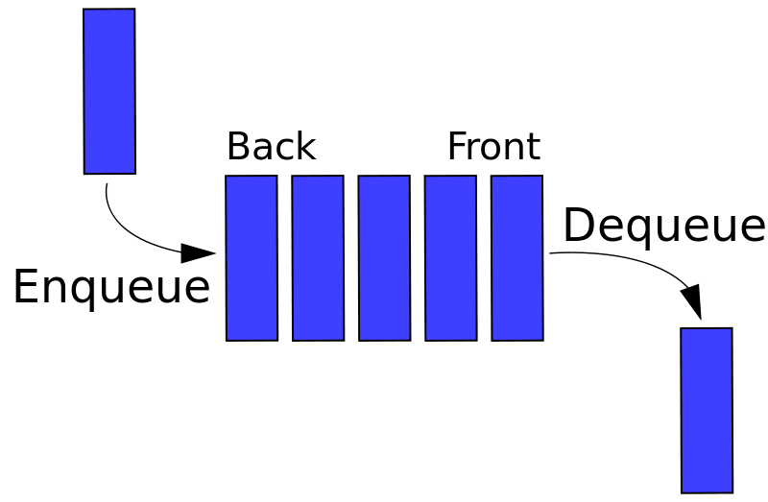
Thread Priority
Threads need some way of regulating themselves
In other words, we need a way of knowing how long and when a thread will get CPU time
Remember that each application can have multiple threads, and that a computer can have hundreds to thousands of threads going at once
Most CPUs have a set of priorities ranging from 1-32, but the JVM has priorities from 1-10
Your platform specific compiler will figure out how to relate your thread priorities to your CPU
We use the setPriority method to set the priority of each thread we create (1 is the lowest, 10 is the highest)

Slide 13
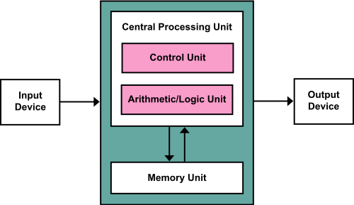
What are Thread Pools?
Thread Pools are used to regulate multiple threads in an application without needing to manually needing to start a thread for each task
Java uses the Executor interface for executing tasks in the thread pool
ExecutorService is a subinterface of executor that is used to manage a Thread Pool
We will use static methods of Executors to create a new Executor object

Slide 14

Race Conditions and Synchronization

Slide 15

Race Conditions
Race conditions are a major source of trouble when dealing with multithreaded applications
What is a Race Condition?
A race condition happens when two threads are trying to modify the same memory object, and depending on the ordering in which they are executed, we will have a different result
In our banking app, this will happen whenever we have different threads trying to modify a single account balance at the same time

Slide 16
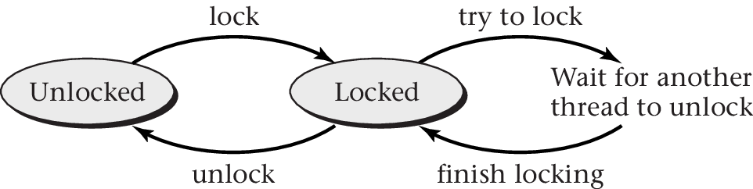
Thread Synchronization
To avoid race conditions we have to synchronize the threads
Thread Synchronization allows us to say that only one thread can simultaneously access a certain part of the program
This region is called the critical region
A method, loop, or any block of code can be deemed synchronized

Slide 17
Thread Synchronization cont.
Any other threads that try and access the thread at this time will be blocked and wait until the other thread using the synchronized region is done
Synchronization allows us to stop race conditions, but what if we want multiple threads to work together
For instance methods, the synchronization occurs on the object
For static methods, the synchronization occurs on the class

Slide 18

Cooperating Between Threads with Conditions

Slide 19
Lock Basics
When we synchronize a section of code, each thread acquires a lock on the object or class, executes the code, then releases the lock
For another class to use this block of code, we need access to the lock
Lock is an interface, ReentrantLock is the concrete implementation
Each lock must have a fairness policy
If fairness is true, the longest waiting thread will get the lock next
Otherwise it will be passed randomly
A fair fairness policy will be slower but will have smaller variances in time to obtain locks and guarantees no starvation

Slide 20
Conditions Basics
Conditions
Conditions are used to facilitate communications amongst threads
Conditions are created by calling newCondition() on a lock object
Await, signal, and signalAll are used for thread communication
Await causes the thread to wait until the condition is signaled
Signal wakes up one waiting thread
SignalAll wakes up all waiting threads
If we don’t explicitly signal a thread, it won’t be accessible and the thread “starves” and dies
In essence, we pass locks between threads to prevent race conditions, and locks are freed and locked by signals
Locks/Conditions in their modern forms were introduced in Java 5

Slide 21

Wrap-Up our Project

Slide 22
Conclusion
Remember we need to free up a lock, otherwise the other thread will never get the lock and get starved
If we create threads in a Java application, the JVM will allow your computer to use multiple threads/CPU cores to tackle your program
It will automatically handle balancing your application with other system applications
Generally, we want a new thread for each task that can execute separately, and when threads need to work together we can use synchronization
We can also pass locks between objects/classes and use conditions and their methods to switch control in our application between various threads
Normally a Java program has only the default main thread

Slide 23

Hope you enjoyed the course!
Future Goals after this Course
Learn how to use multithreaded applications in client server apps to have multiple connections at once
Apply multithreading to one of your existing applications to increase its speed
Remember, the best way to practice programming is by making programs
Please leave feedback so I can continue to improve my courses

